Slide 1


Data Science Bootcamp
#1 rated Coding and Data Science Program in all of Orange County, Los Angeles, and the Inland Empire.
Prep Course Introduction - Statistics

Slide 2


Statistics
Statistics is the discipline that is concerned with the collection, organization, analysis, interpretation, and presentation of data.
Source: https://en.wikipedia.org/wiki/Statistics
Statistics is a science of collecting and analyzing data taken from a sample population
Notes:
The goal is to turn data into knowledge

Slide 3
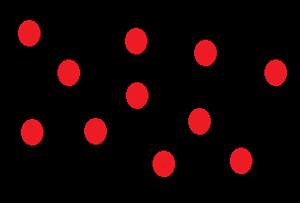
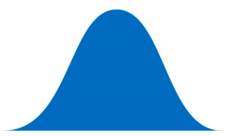
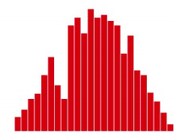
Population vs Sample
Population
Population
Sample
Sample
Notes:
the first message for statistical thinking is, statistics derives knowledge from sample regarding the population by carefully conducted collection and data
Example of US election survey and its results

Slide 4
Population vs Sample
Sample
Sample is the specific group that you collect data from. To be a truly random sample, every subject in your target population must have an equal chance of being selected in your sample.
Population
Population is the broader group of people to whom you intend to generalize the results
Notes:
the first message for statistical thinking is, statistics derives knowledge from sample regarding the population by carefully conducted collection and data
Example of US election survey and its results
the first message for statistical thinking is, statistics derives knowledge from sample regarding the population by carefully conducted collection and data

Slide 5
Population vs Sample
N = Total population
n = Total sample from population

Slide 6
Population vs Sample
Sample A subset from a larger data set.
Population The larger data set or idea of a data set.
N (n) The size of the population (sample).
Random sampling Drawing elements into a sample at random.
Simple random sample The sample that results from random sampling without stratifying the population.
Sampling with replacement and without replacement

Slide 7
Data
Data Generation
Data Collection
Knowledge
Business Intelligence
Solutions
Notes:
We have little control on data generation
From generated data we gather data to analysis
We want to drive knowledge, business intelligence and solution based on our data

Slide 8
Data
Assumptions about data sampling
Randomization
Measurements of the data
Independence between variables

Slide 9
Bootstrap and resampling
Bootstrap sample A sample taken with replacement from an observed data set.
Resampling The process of taking repeated samples from observed data; includes both bootstrap and permutation (shuffling) procedures.
Notes:
Multiple samples are combined and the sampling may be done without bootstrap

Slide 10
Data
5
Data is usually a number, for a unit of observation and has a context
Notes:
Data is usually a number, for a unit of observation and has a context
Does 5 mean Age of 5 - years
Height of the person 5 feet
Weight of the person 5 pounds
Does it mean 5ml of rain

Slide 11
Type of data
Types of variable
Quantitative variables
Qualitative variables
Date and time

Slide 12
Quantitative Variable
Types of Quantitative variable
Continuous variables
Discrete variables

Slide 13
Qualitative Variable
Types of Qualitative variable
Ordinal variables
Nominal variables

Slide 14
Fundamental Ideas
Variance
Estimates of Location
Uncertainty
Probability

Slide 15
Statisticians and Data scientists
A sample to a statistician means a collection of rows.
Data scientists will use the term sample for a single row

Slide 16
Statisticians and Data scientists
Statistician, predictor variables are used in a model to predict a response or dependent variable.
For a data scientist, features are used to predict a target.

Slide 17
Centrality Measures/ Descriptive statistics
Central tendency measures, which capture the center around which the data is distributed.
Variation or variability measures, which describe the data spread, i.e. how far the measurements lie from the center.

Slide 18
Central tendency measures
Mean
Arithmetic mean
Weighted mean
Geometric mean
Median
Mode
Notes:
geometric mean is a mean or average, which indicates the central tendency or typical value of a set of numbers by using the product of their values (as opposed to the arithmetic mean which uses their sum).

Slide 19
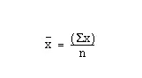
Mean
Average
μ = Mean of population
x = Mean of sample

Slide 20
Mean
Let’s write a function to calculator mean of a given dataset
1, 2, 4, 5, 5, 7, 8, 9

Slide 21
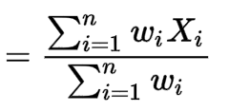
Weighted Mean
μ = Mean of population
x = Mean of sample

Slide 22
Weighted Mean
Let’s write a function to calculator mean of a given dataset
Weighted Values Student 1 Students 2
HW | 15%
Quiz | 15%
Mid term | 35%
Final | 35%
HW | 78
Quiz | 70
Mid term | 89
Final | 94
HW | 100
Quiz | 97
Mid term | 76
Final | 79

Slide 23
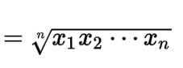
Geometric Mean
μ = Mean of population
x = Mean of sample

Slide 24
Geometric Mean
Let’s write a function to calculate geometric mean of a given dataset
1, 2, 4, 5, 5, 7, 8, 9

Slide 25
Median
Any number, y, for which 50% of the data is <= y and 50% is >= y
1, 2, 4, 5, 5, 8, 9
1, 2, 4, 5, 6, 7, 8, 9 → y 𝞊 [5, 6] (often say y=5.5)

Slide 26
Mode
The most frequent number in the dataset
1, 2, 4, 5, 5, 8, 9
1, 2, 4, 5, 5, 6, 6, 8, 9 → multimodal

Slide 27
Estimates of Location
(Sample) Mean: The sum of all values divided by the number of values. Synonyms: average
Median: The value such that one-half of the data lies above and below. Synonyms: 50th percentile
Mode: The most frequent value
Outlier: A data value that is very different from most of the data. Synonyms: extreme value

Slide 28
Estimates of Location
Mean: The sum of all values divided by the number of values. Synonyms: average
Weighted mean: The sum of all values times a weight divided by the sum of the weights. Synonyms: weighted average
Geometric mean is calculated by multiplying all numbers and then taking the nth root of that number (where n=number of numbers).
Trimmed mean: The average of all values after dropping a fixed number of extreme values. Synonyms: truncated mean

Slide 29
Variability Measures
Variance
Standard Deviation
Coefficient of Variation
Quantiles
Notes:
geometric mean is a mean or average, which indicates the central tendency or typical value of a set of numbers by using the product of their values (as opposed to the arithmetic mean which uses their sum).

Slide 30
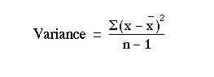
Variance
Spread of data around the mean
𝛔² = Variance of population
S² = Variance of sample
Notes:
Why divide by n-1 : https://www.willemsleegers.com/post/2020/08/05/why-divide-by-n-1/
Bias and unbias : https://www.merriam-webster.com/dictionary/unbiased

Slide 31
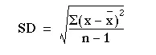
Standard Deviation
Square root of variance
𝛔 = Standard deviation of population
s = Standard deviation of sample

Slide 32
Example
What are the variance and standard deviation of the following sample?
1, 2, 4, 4, 6, 7, 7, 9

Slide 33
Answers
Variance = 7.43
SD = 2.73

Slide 34
Coefficient of Variation
Compare two datasets which operate on different scales i.e inches and centimeters
Coefficient of variation = Standard deviation / Mean
Inches = 60, 66, 72, 70
Centimeters = 152.4, 167.64, 182.88, 177.8

Slide 35
Quantiles
N-Quantiles
Dividing lines of data set into N equal parts
Special cases: Quartile (4 equal parts), percentile (100 equal parts)
1, 2, 3, 4, 5, 6, 7, 8 → 1st quartile is between 2 and 3, 2nd (median) is between 4 and 5, etc.
Interquartile Range (IQR)
Interquartile range: The range between the 25th percentile and the 75th percentile.

Slide 36
Variability - Multiple Variables
Covariance
Correlation
Spearman’s Correlation

Slide 37
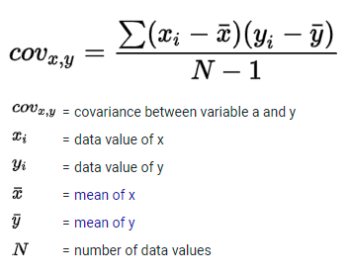
Covariance
How does one variable move with another variable - what is their relationship?

Slide 38
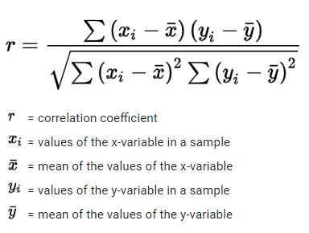
Correlation coefficient
r = Covariance(x,y) / S(x) * S(y)
1 is perfect positive correlation
-1 is perfect negative correlation
0 means no correlation

Slide 39
Example
What are the covariance and correlation coefficient between height and weight?
Hint: avg height = 67in, avg weight = 155lb
Height (in) | Weight (lb)
60 | 110
66 | 140
72 | 190
70 | 180

Slide 40
Answers
Covariance = 193.33 in*lb
Correlation = 0.988

Slide 41
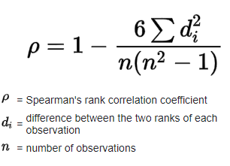
Spearman Correlation Coefficient
The Spearman's rank-order correlation is the nonparametric version of the Pearson product-moment correlation. Spearman's correlation coefficient, (ρ, also signified by r_{s}) measures the strength and direction of association between two ranked variables.
Notes:
https://www.youtube.com/watch?v=FNVdFV4fLfs

Slide 42
Hypothesis Testing
Alternative Hypothesis: What we suspect to be true - what we are testing for
E.g. one drug has higher efficacy than another
Null Hypothesis: (Usually) The opposite of the alternative hypothesis - what we want to show is incorrect
E.g. both drugs have same efficacy

Slide 43
Hypothesis Testing
Generate a test statistic, which is random variable based on a sample from a random distribution and often contains measure of central tendency and/or variability for that distribution
We assume null hypothesis is true and show whether the probability of getting the value of our test statistic exceeds a certain threshold based on the level of significance

Slide 44
Statistical Tests
Z Test
t Test
F Test
Chi-Square Test

Slide 45
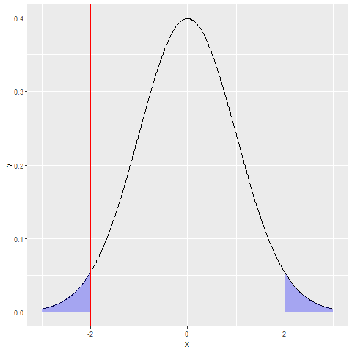
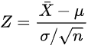
Z Test
Z is distributed as a Standard Normal Z~N(0, 1)
Sigma, Xbar, and n are known
Tests whether our guess of mu (mean of population) is statistically significant

Slide 46
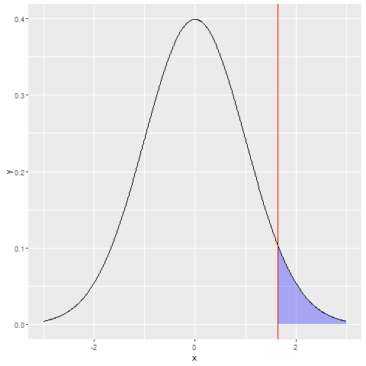
One-Sided Z Test

Slide 47
Example
Say we collect the following height data (in inches): [60, 68, 62, 63, 72, 68, 74, 60, 65, 60]. Assume we know this data comes from a Normal distribution with standard deviation 2.
Can we claim that the mean population height is greater than 65in at the .05 level of significance? (Bonus: What about mean height > 64in? What about standard deviation 1?)

Slide 48
Answer
No. The Z-score is ~1, but the critical value is 1.645. Since 1<1.645 we fail to reject the null hypothesis and cannot assume mean height is greater than 65in.
If question is rephrased from 65in->64in, we get Z-score ~6 so we reject the null hypothesis. If sd=1, we get Z-score ~2 so we reject the null.

Slide 49
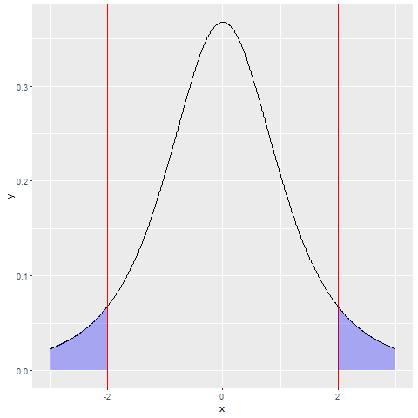
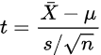
t Test
t is distributed as the Student’s T-Distribution with n-1 degrees of freedom t~T(n-1)
Xbar, and n are known; Sigma is unknown - use sample standard deviation, s, to estimate
Tests whether our guess of mu (mean of population) is statistically significant

Slide 50
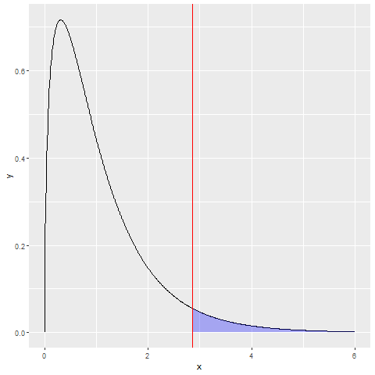
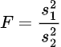
F Test
F has the F-Distribution with n₁-1 and n₂-1 degrees of freedom (n₁=# obs from pop 1, n₂=# obs from pop 2)
s₁² and s₂² are sample variances
Tests whether populations have equal variance (both pops should be roughly Normal)

Slide 51
Example
If we have a sample of heights from one population - [60, 68, 62, 63, 72, 68, 74, 60, 65, 60], and another sample from another population - [61, 62, 65, 64, 61, 72, 65, 66, 62, 63], can we say that the two populations have variances that are different at the .05 level of significance?
(Bonus: What if the second sample is [66, 65, 66, 66, 67, 66, 64, 65, 66, 66]?)

Slide 52
Answers
The critical value is 3.18, so in the first case we fail to reject the null (equal variances) since F=2.43 and in the second case we reject the null since F=38.62 and conclude that the variances are different.

Slide 53
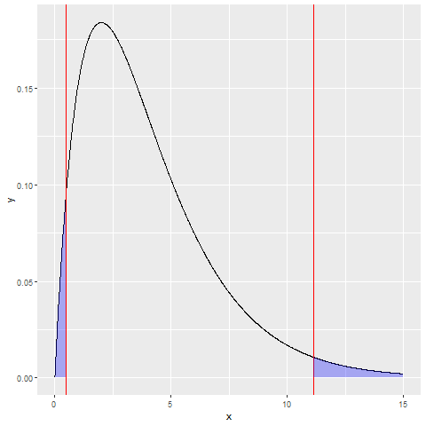
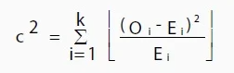
Chi-Square Test
Tests (among other things) that n samples have equal distribution amongst set of m categories
c² is 𝜒²-Distributed with (n-1)*(m-1) degrees of freedom
O_{i} is observed frequency for each category and E_{i} is expected frequency (based on reference sample)
Notes:
Chi squared statistic = https://www.youtube.com/watch?v=5Nrq_jqu9Ao

Slide 54
Association between quantitative variables
Statistic used to measure association between quantitative variables is called correlation. It is a single number of statistics for linear association. Correlation is a measure of linear association.
Notes:
Odd’s ratio = p1/(1-p1) / p2/(1-p2)
= 2.846 / 0.219
= 12.995

Slide 55
Data Structures
Rectangular data (Structured data)
Unstructured data
Time series data
Spatial data
Graph (or network) data
Notes:
Graph refers to connections among entities, and to the underlying data structure. In statistics, graph is used to refer to a variety of plots and visualizations,

Slide 56
Variability Metrics
Deviations: The difference between the observed values and the estimate of location. Synonyms errors, residuals
Variance: The sum of squared deviations from the mean divided by n – 1 where n is the number of data values. Synonyms mean-squared-error
Standard deviation: The square root of the variance.

Slide 57
Variability Metrics
Mean absolute deviation: The mean of the absolute value of the deviations from the mean.
Median absolute deviation from the median: The median of the absolute value of the deviations from the median.

Slide 58
Variability Metrics
Interquartile range: The difference between the 75th percentile and the 25th percentile. Synonyms IQR

Slide 59
Estimates of Location
Median: The value such that one-half of the data lies above and below. Synonyms 50th percentile
Weighted median: The value such that one-half of the sum of the weights lies above and below the sorted data.

Slide 60
Central limit theorem
Sample statistic A metric calculated for a sample of data drawn from a larger population.
Data distribution The frequency distribution of individual values in a data set.
Sampling distribution The frequency distribution of a sample statistic over many samples or resamples.
Central limit theorem The tendency of the sampling distribution to take on a normal shape as sample size rises.
Standard error The variability (standard deviation) of a sample statistic over many samples (not to be confused with standard deviation, which, by itself, refers to variability of individual data values).

Slide 61
Central limit theorem
Means drawn from multiple samples will resemble the familiar bell-shaped normal curve (see “Normal Distribution”), even if the source population is not normally distributed, provided that the sample size is large enough.
Standard error can be estimated using a statistic based on the standard deviation s of the sample values, and the sample size n.
SE = s/(n)^1/2

Slide 62
Key terms
Error The difference between a data point and a predicted or average value.
Standardize Subtract the mean and divide by the standard deviation.
z-score The result of standardizing an individual data point.
Standard normal A normal distribution with mean = 0 and standard deviation = 1
Tail The long narrow portion of a frequency distribution, where relatively extreme values occur at low frequency.
Skew Where one tail of a distribution is longer than the other.

Slide 63
Central tendency measures
Mean
Arithmetic mean
Geometric mean
Median
Mode

Slide 64
Variation or variability measures
Variance
Standard deviation
Range
Interquartile Range (IQR)

Slide 65
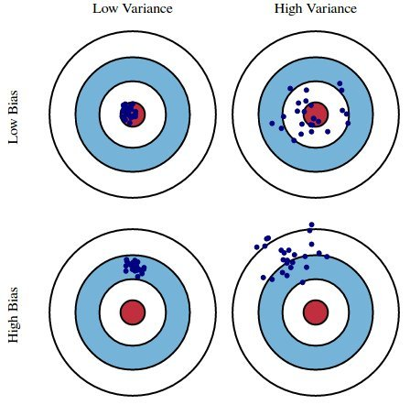
having an expected value equal to a population parameter being estimated
Bias vs Variance

Slide 66
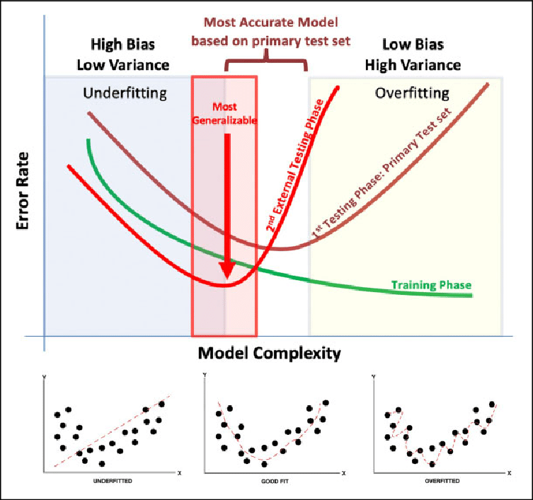
Bias vs Variance

Slide 67
DATA SCIENCE ADDITIONAL READINGS
ASA Whitepaper: Discovery with Data: Leveraging Statistics with Computer Science to Transform Science and Society. http://www.amstat.org/policy/pdfs/BigDataStatisticsJune2014.pdf
A Cartoon Guide to Statistics http://www.amazon.com/Cartoon-Guide-Statistics-Larry-Gonick/dp/0062731025
Naked Statistics http://www.amazon.com/Naked-Statistics-Stripping-Dread-Data/dp/1480590185

